Slide 1
MILESTONE 3
MedAssist AI 🏥AI-Powered Healthcare Assistance Platform
Recommendation Engine & Analytics Dashboard — review for academic mentor
Milestone 3
Recommendation Engine & Healthcare Analytics
Karumanchi Hemanth 8/27/2026
Infosys Springboard Internship

Slide 2
MILESTONE 3
Milestone 3 Deliverables
Patient journey
01
Symptoms
01 — Healthcare Recommendation Engine
02 — Treatment & Preventive Suggestions
03 — Risk-Based Healthcare Advisory
04 — Disease Prediction Reports
05 — Healthcare Analytics Dashboard
02
Prediction
03
Risk assessment
04
Recommendations
05
Advisory Guidance
06
Prediction Report
From AI output to patient-ready insight
07
Healthcare Analytics
MEDASSIST AI | INTERNSHIP REVIEW
01

Slide 3
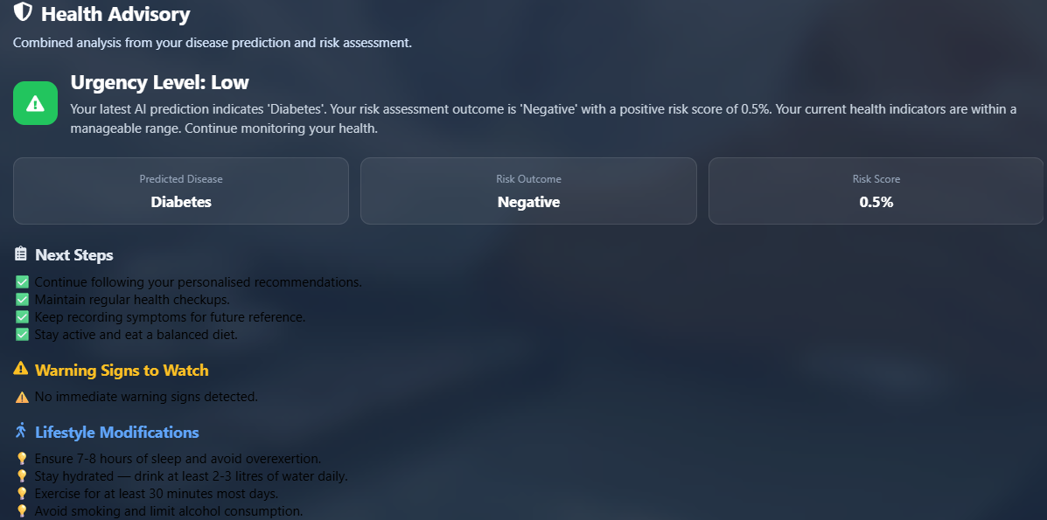
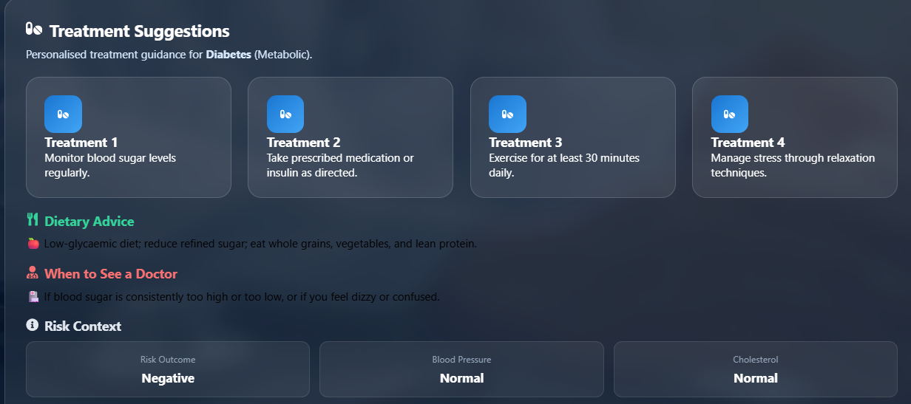
Healthcare Recommendation & Advisory Engine
Combines predicted disease, risk level, and patient context to turn
model output into practical healthcare guidance.
Decision flow
Disease prediction
Top conditions + probabilities
Risk assessment
Risk level + contributing factors
Advisory engine
Treatment, prevention, lifestyle guidance
Prediction → Risk → Guidance
MEDASSIST AI | MILESTONE 3
02

Slide 4
Disease Prediction Reports
Converts the assessment into a structured, shareable report that can be viewed in the application and downloaded as a PDF.
Report contents
Patient information
MEDASSIST AI
Prediction summary
Symptoms considered
Disease Prediction Report
Predicted disease
Bronchial asthma
Predicted disease and probabilities
Confidence
86%
Risk assessment result
Patient: Virat Kohli Generated: 23 Jul 2026
Recommendations and advisory
Risk level
Moderate
Generation date and record details
Bronchial asthma
Recommendations
Included
Usable output for patients, caretakers, and academic review
VIEW / DOWNLOAD PDF
MEDASSIST AI | MILESTONE 3
03

Slide 5
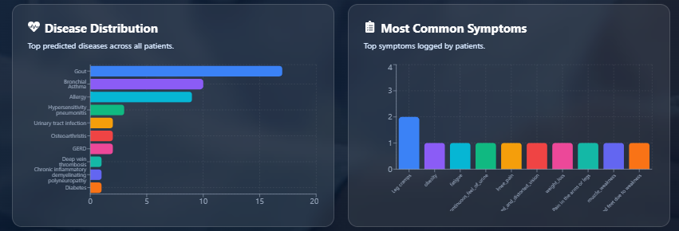
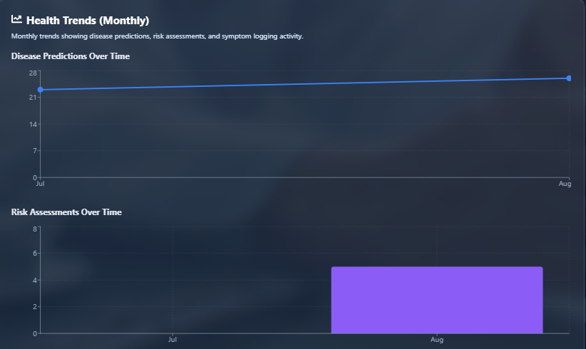
Healthcare Analytics Dashboard & Health Trends
Aggregates patient records into a monitoring view for disease
distribution, risk patterns, symptom activity, and change over time.
Dashboard metrics
Total Patients
Total Symptoms
Total Predictions
High-Risk Cases
Analytics
Disease Distribution
Risk Distribution
Symptom Statistics
Prediction Probabilities
MEDASSIST AI | MILESTONE 3
04

Slide 6
